Slide 1
PHP AJAX
USER MANAGEMENT SYSTEM
Eman Gumayagay

Slide 2
REQUIREMENTS
PHP / XAMPP
BROWSER (Google / Edge / Internet Explorer)
VSCode / Other Code Editor
Brain

Slide 3
STEPS BY STEPS

Slide 4
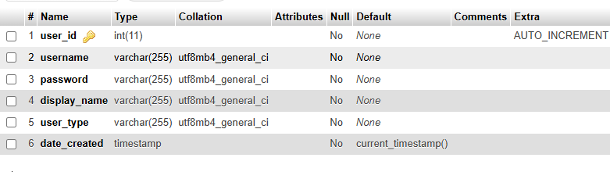
Project Setup
Create new Folder for your project, and open it on your VSCode
Open your Xampp
Start service of [Apache and MySql]
Open on the browser: http://localhost/phpmyadmin
Create your database: ex: ajax_crud
Create table name it: users
Follow the columns

Slide 5
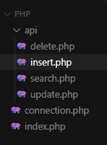
Project Structure
A project structure has these php files:
As we can see, we have specific files for
our api, to insert, update, search or delete from database.
Don’t forget the
index.php and connection.php

Slide 6
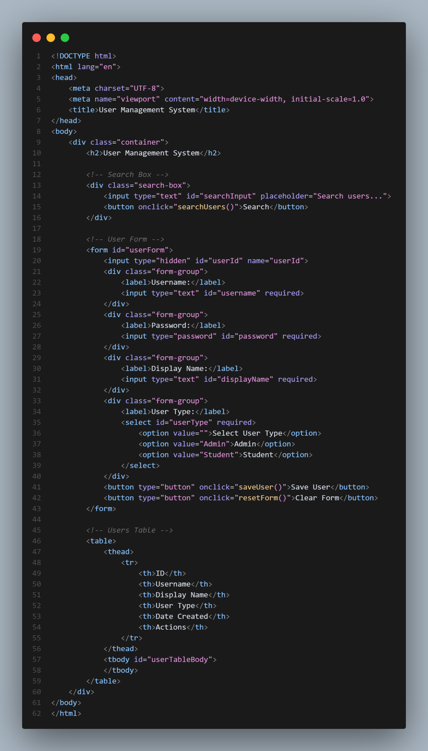
Outline our HTML
Now we need to create an outline and setup our forms, for our User Management System
Username
Password
Display Name
User Type

Slide 7
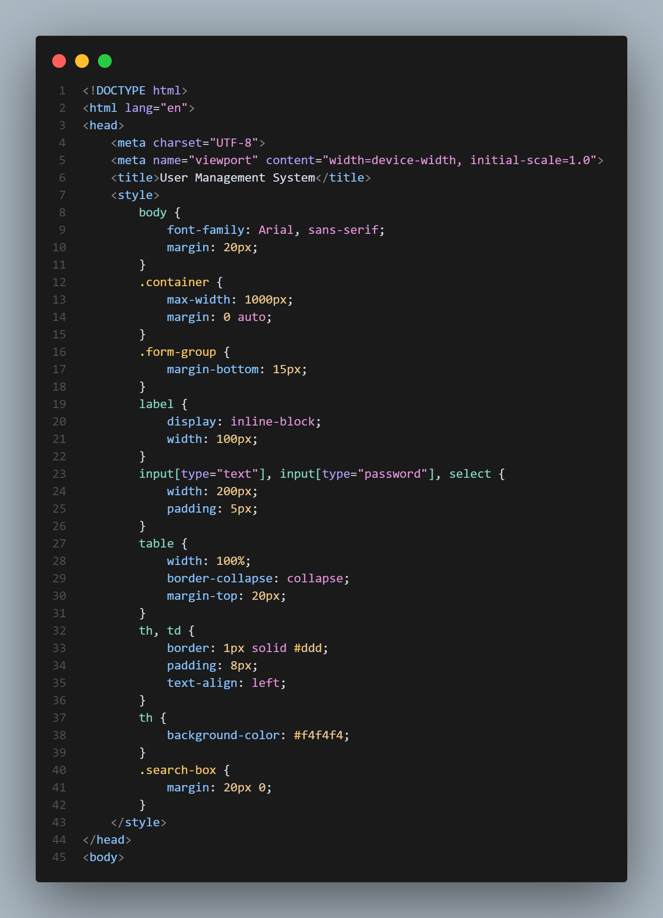
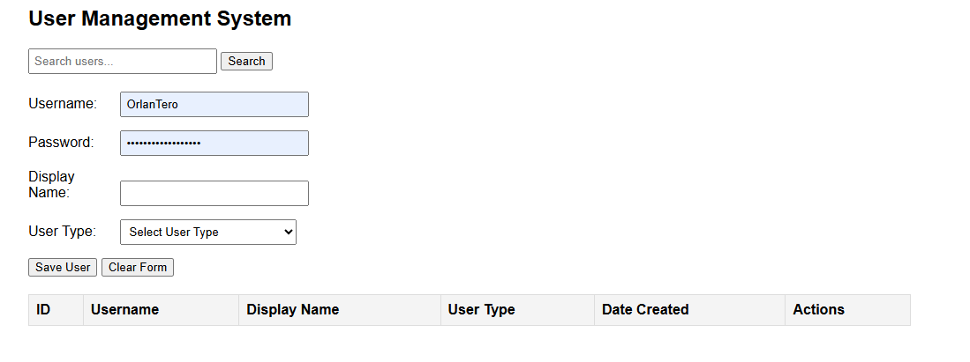
Add Simple Style
Add CSS style to design our HTML as simple as we can

Slide 8
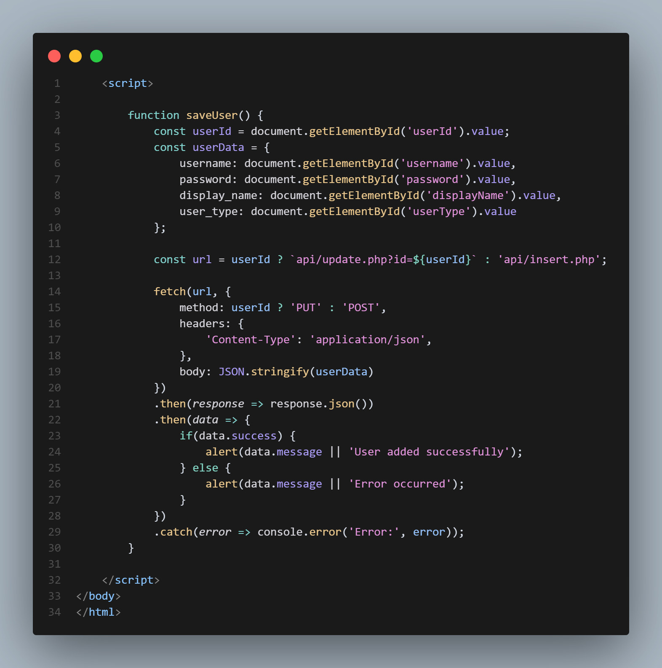
Insert [ADD USER]
Implement saveUser function in our index.php that will call our file api/insert.php and return it’s result.

Slide 9
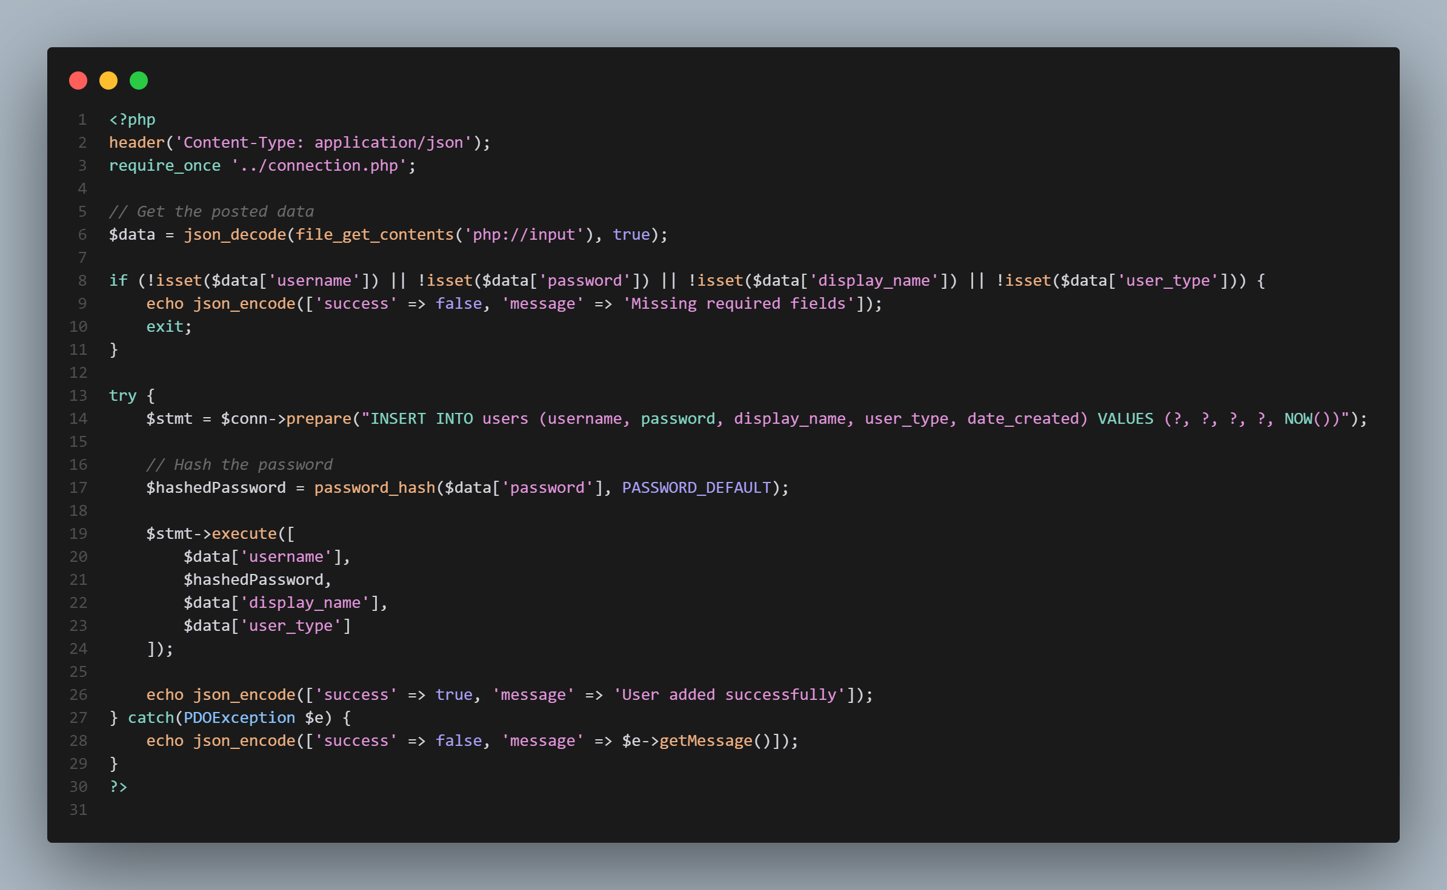
Insert API
Implement saveUser function in our index.php that will call our file api/insert.php and return its result.

Slide 10
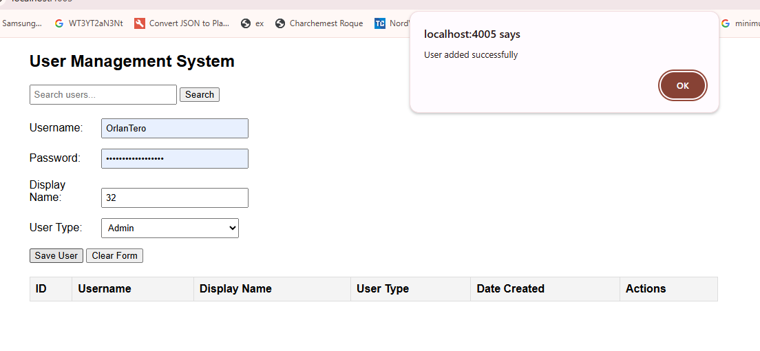
TEST [INSERT]
Now test inserting new user, it should prompt the Success message and save it to the database

Slide 11
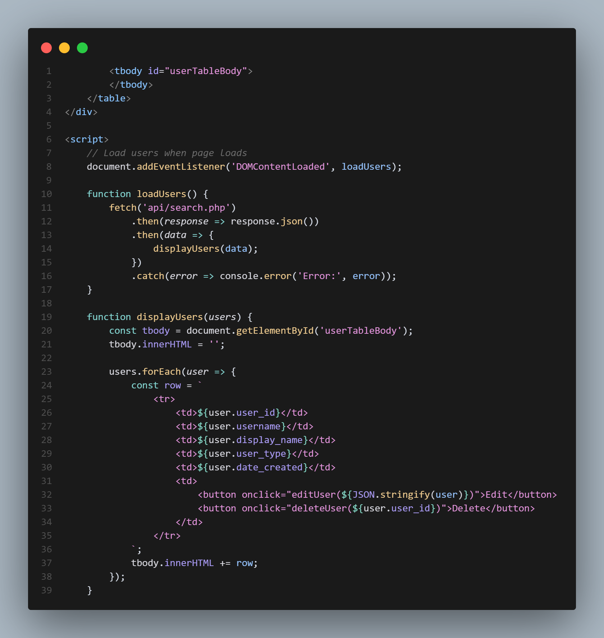
Display [Users]
We’ve created two function which is, loadUsers and displayUsers
loadUsers will fetch all of the users, via search but passing no params or values, so it will return all of the values.
displayUsers will create dynamic rows and add it to our table for display.

Slide 12
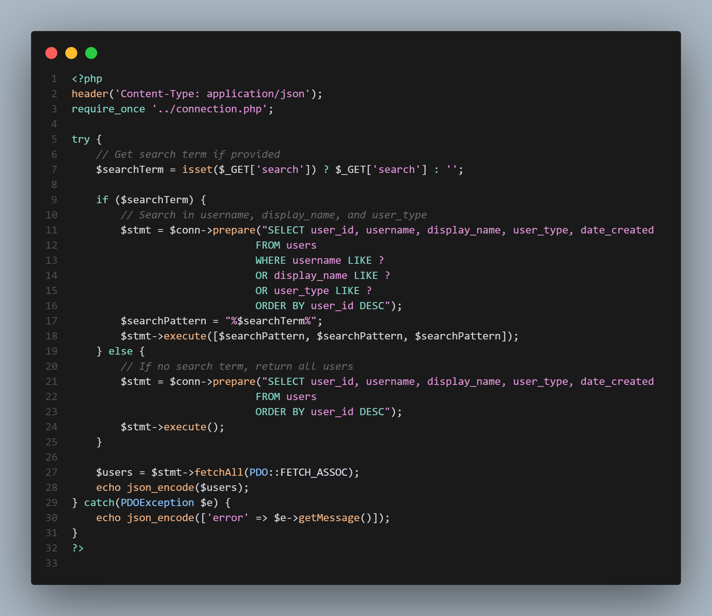
Search or Read API
Implement an search API where it filters users via term, and return users

Slide 13
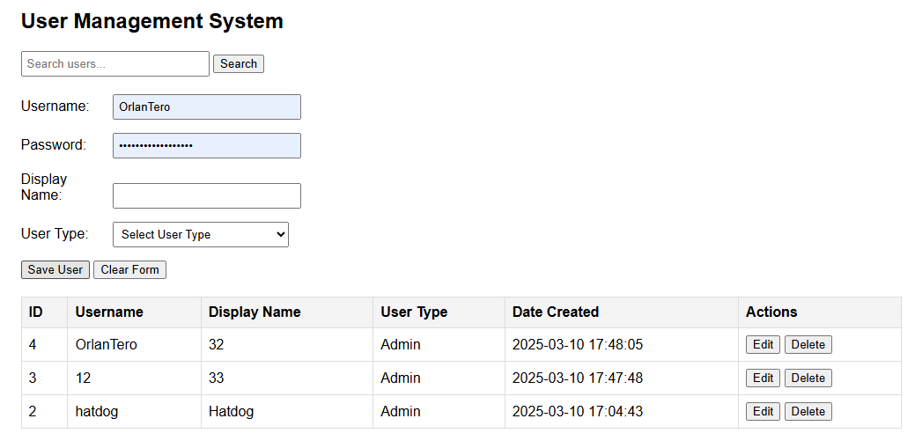
TEST [DISPLAY]
As

Slide 14
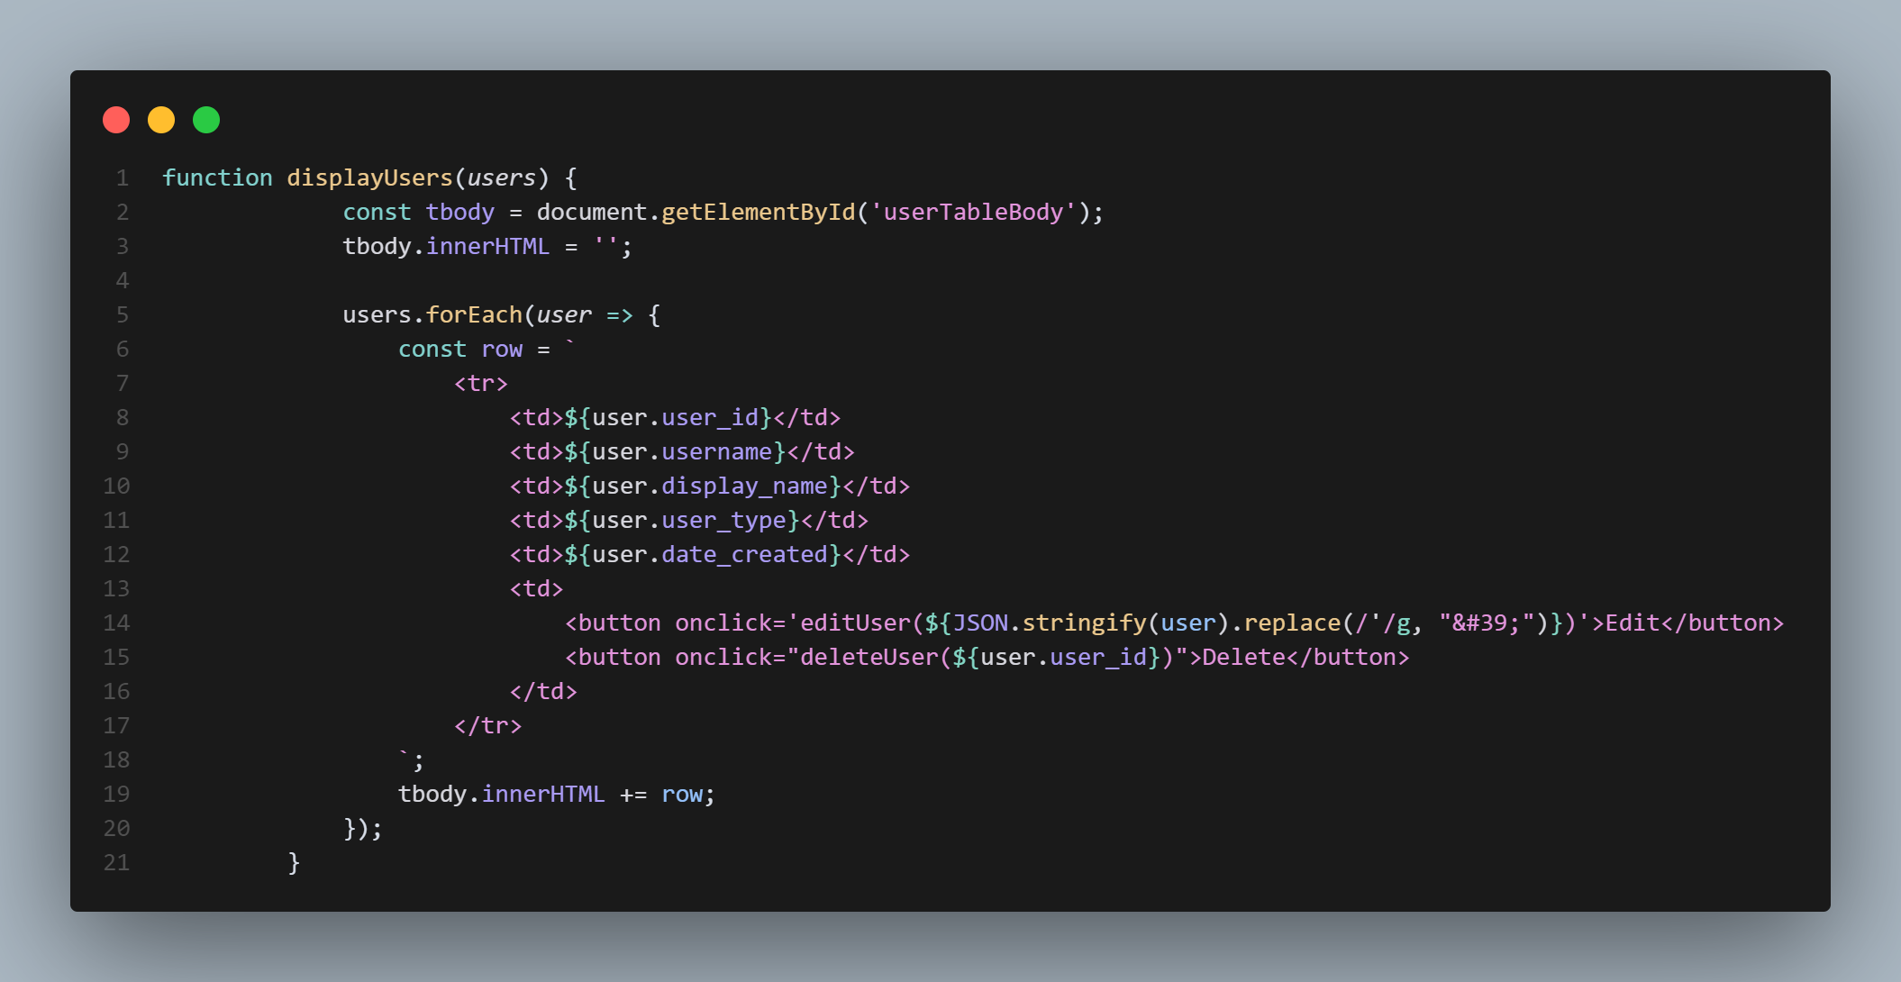
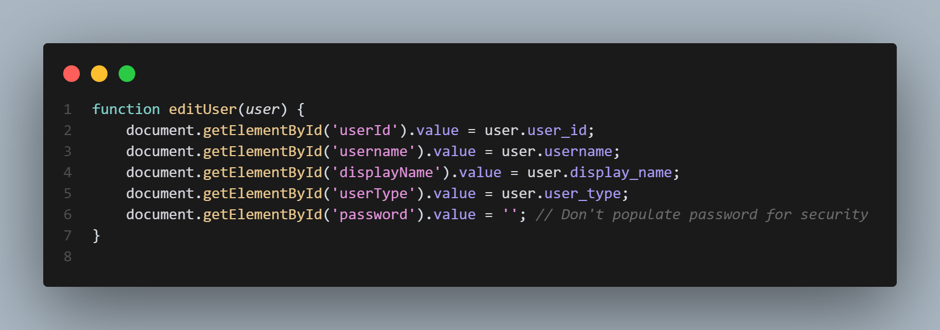
Update [User]
Implement a functionality where user can update specific user, with an updated information provided. But here, were just updating the fields with the user_id, as a flag for update

Slide 15
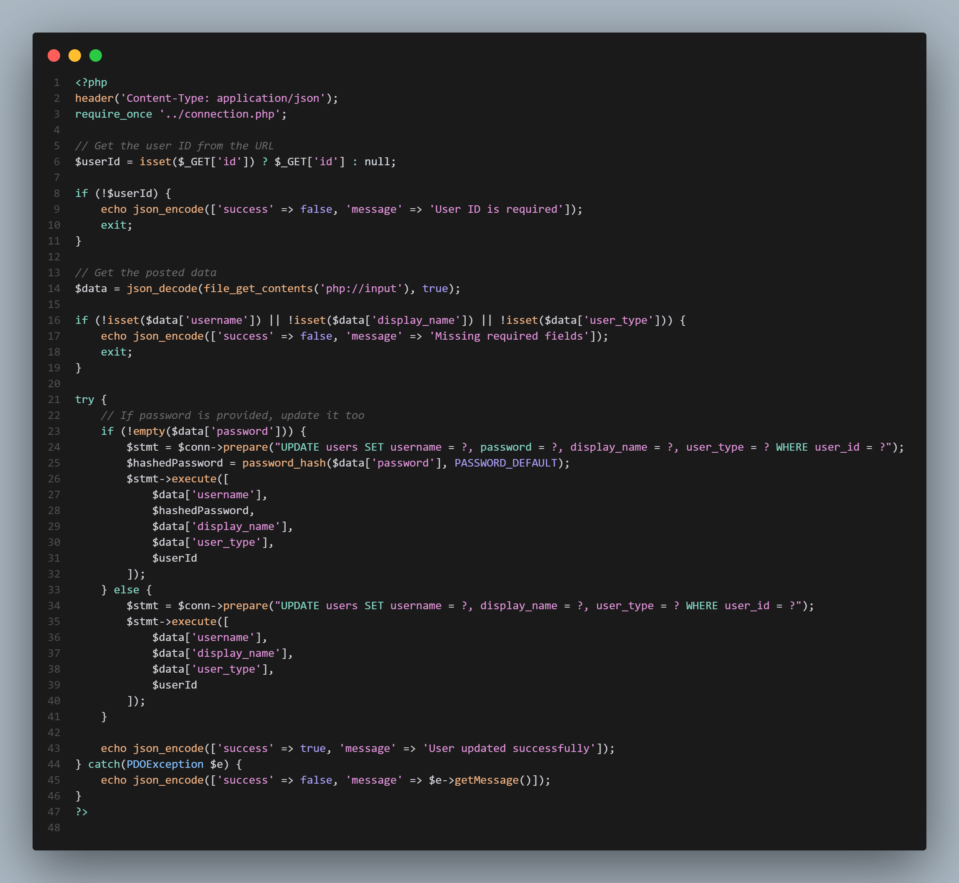
Update API [USER]
Now in our update.php, write these functions,
These will alter the information of the selected user

Slide 16
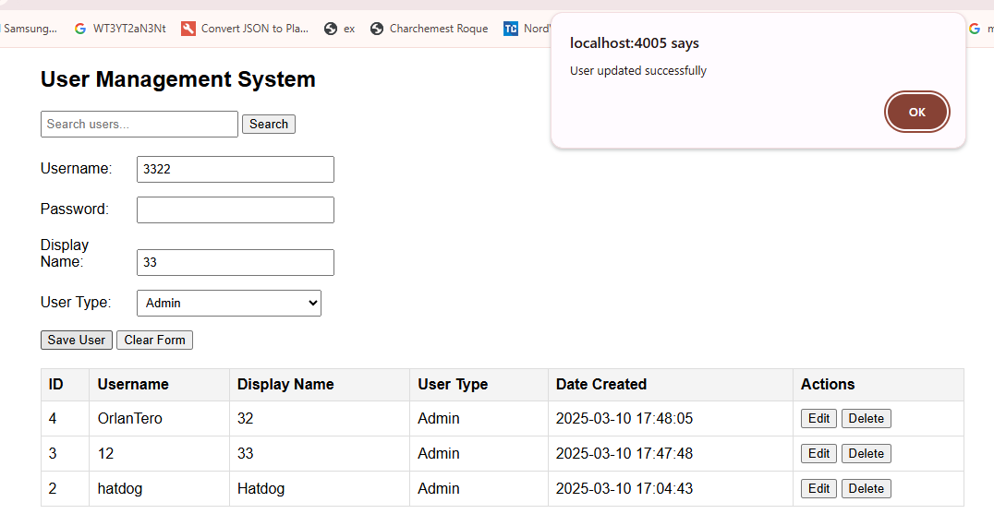
TEST [UPDATE]
On clicking Edit on each rows, then clicking save user after updating information, we will see a prompt for success update.

Slide 17
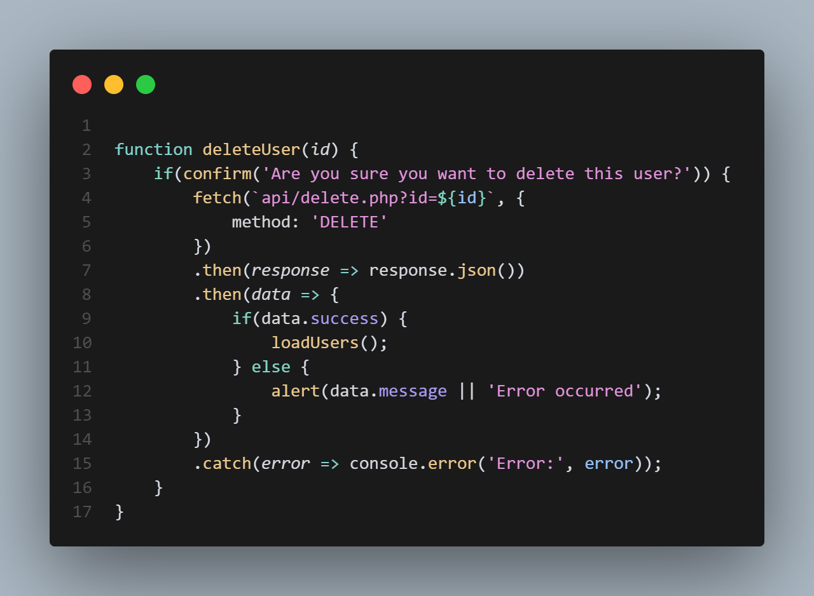
Delete [User]
Implement a new functionality where user can delete specific user at row passing their id for reference as deletion.
It will call the delete.php and return a response

Slide 18
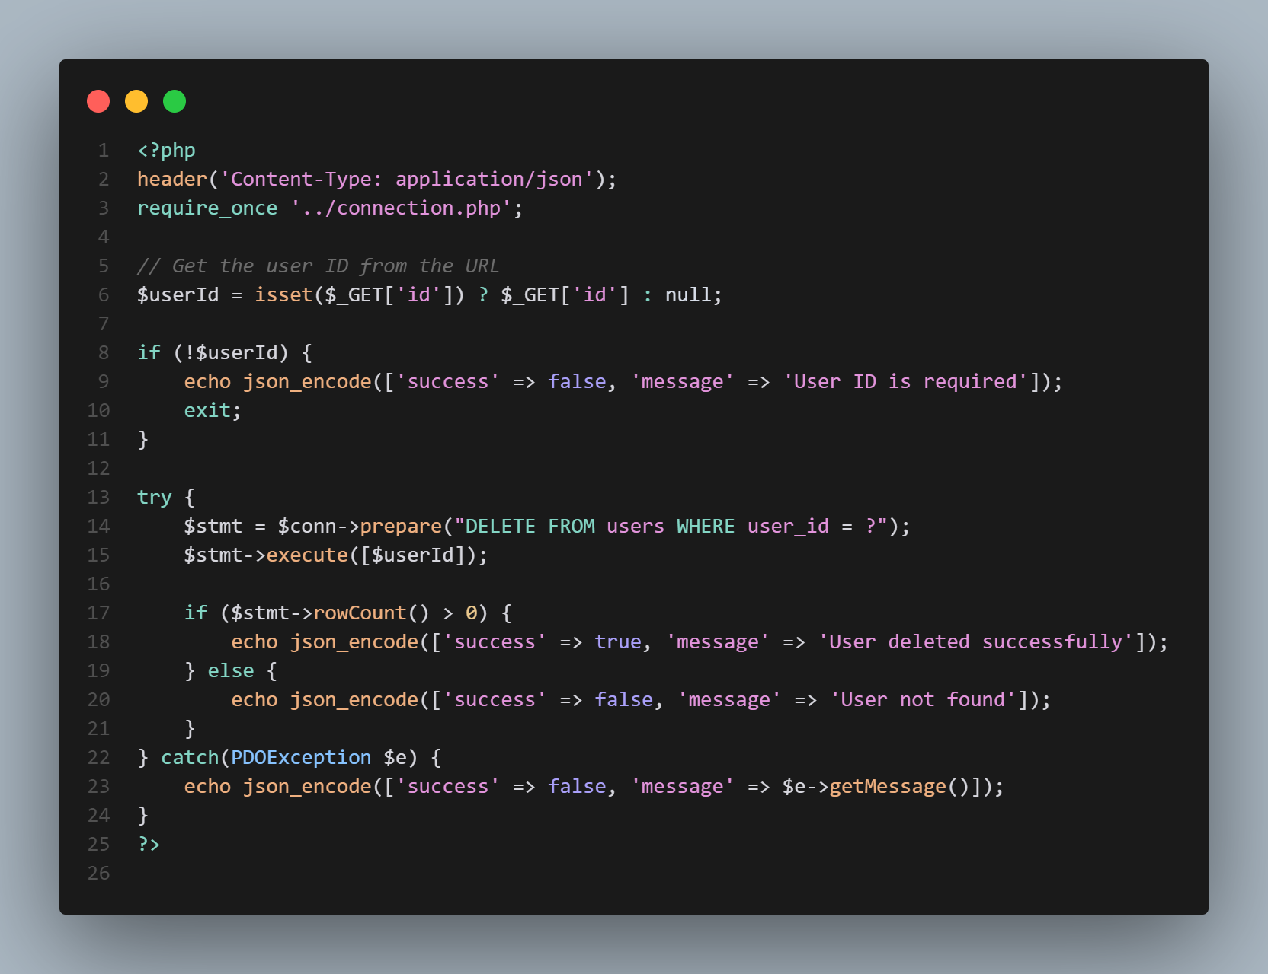
Delete API [USER]
Now in our delete.php, write these functions,
These will delete specific user using their id

Slide 19
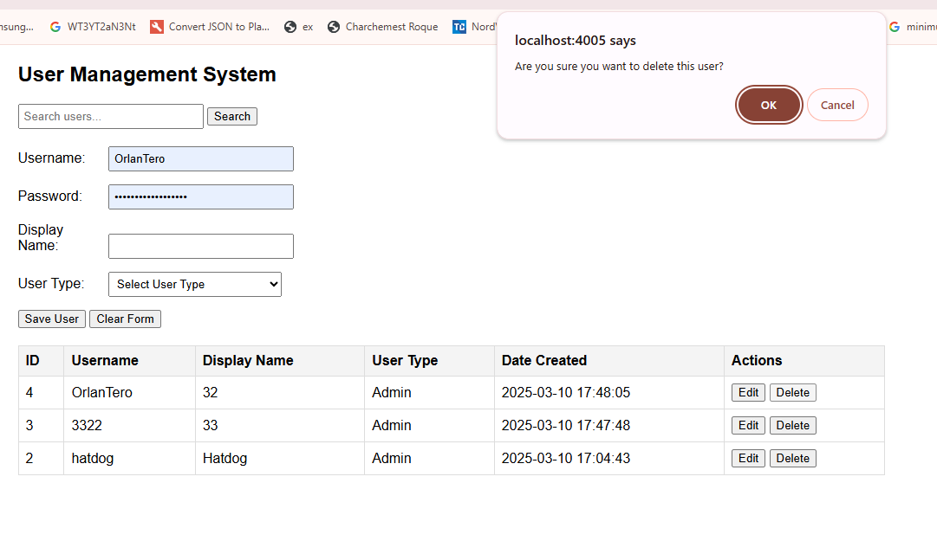
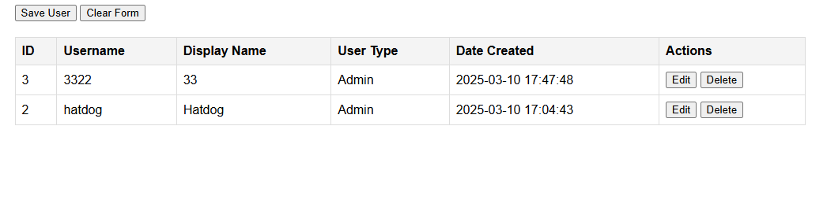
TEST [DELETE]
On clicking Delete on each rows, it will prompt a confirmation to delete.

Slide 20
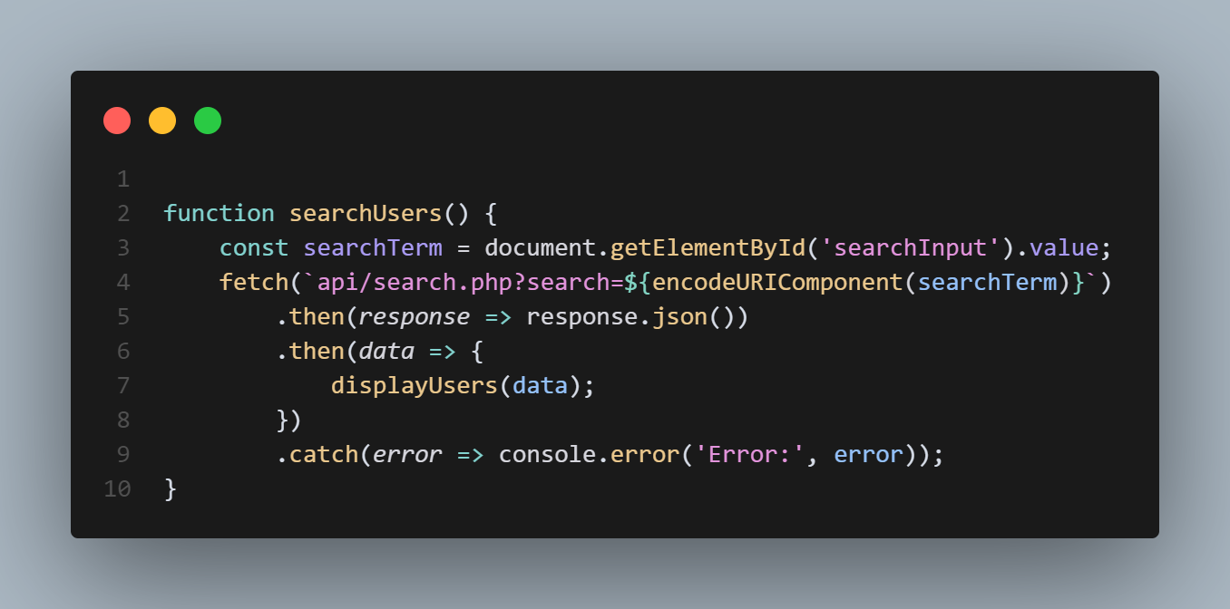
Search
When searching on search box, it will call search.php and provide term for filtering.
And display it on our table

Slide 21
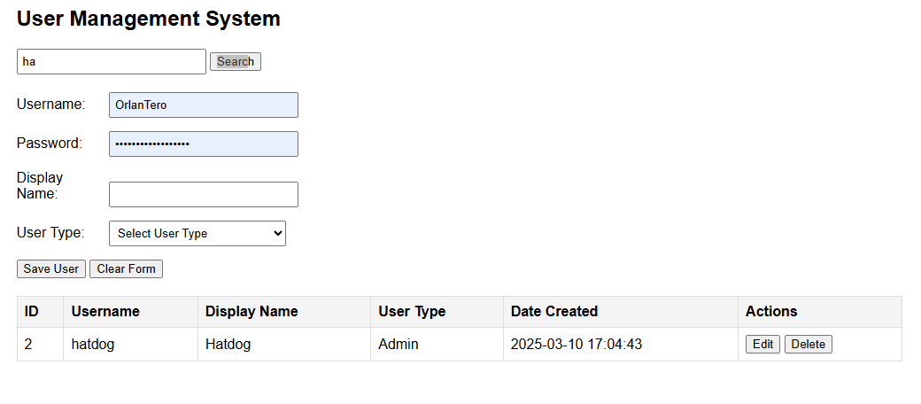
TEST [SEARCH]
On inputing and clicking search, it will search the user and display to table.

Slide 22
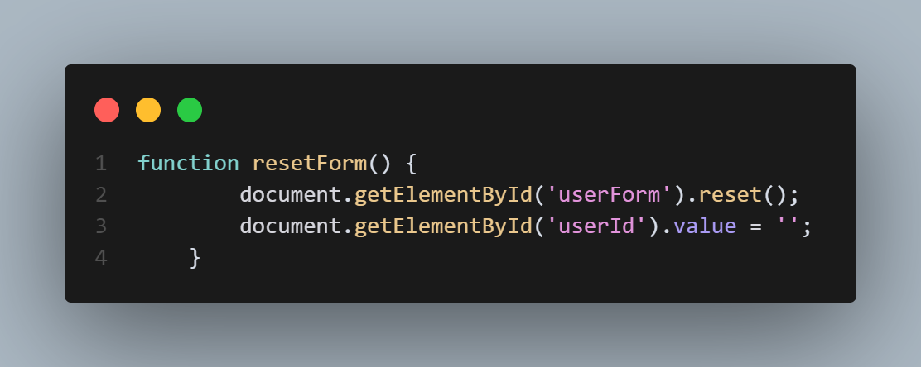
Reset
So when clicking a reset button, call the reset function and reset all of the fields for new entry.

Slide 23
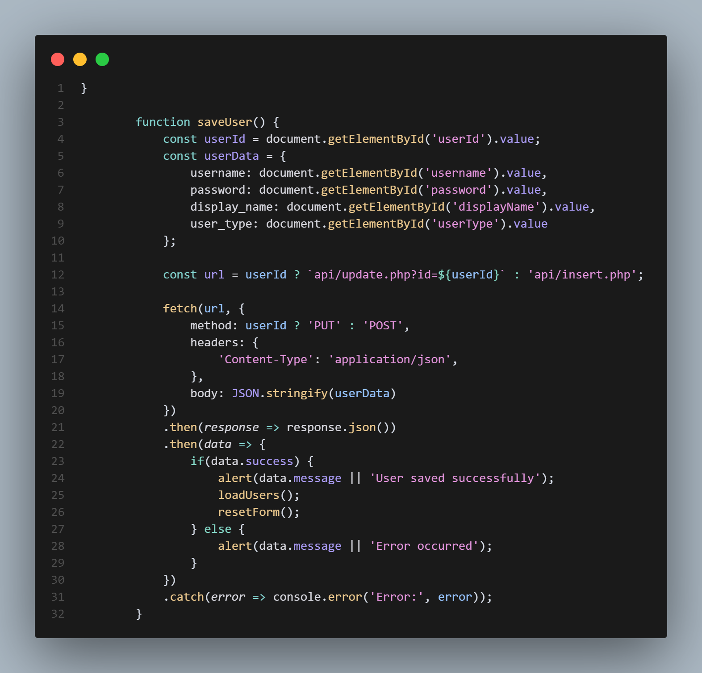
Callback
So after retrieving the users table in database, since we are using ajax, we need to load the table for updated, and also reset the form.

Slide 24
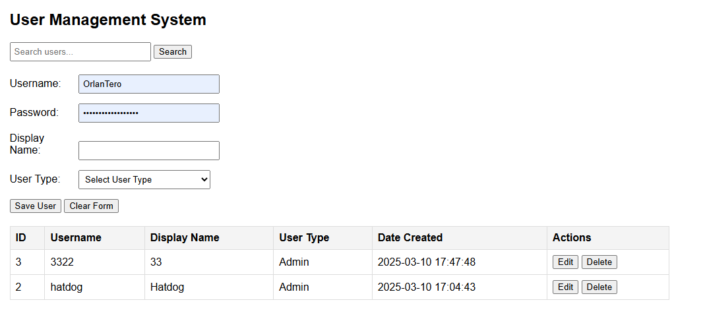
Yey!, Completed
Now, we completed all of it’s functionality, you can now, add new user, update, delete, search, or clear the form for new entry.

Slide 25
Style It, Explore It: Activity
Now, It’s your turn, Make it yours, DESIGN the UMS, explore or add new functionalities

